Slide 1
Day 7: Choosing Your Dataset and figure

Slide 2
Today’s goals
Choose a dataset.
Identify the variables you want to analyze.
Write your null and alternative hypothesis.
Choose the figure you want to create.
Start writing your code if there is time.

Slide 3
Before we begin today’s goals…
Let’s review how we create our own R markdown document. You will use this empty document to write your own code.
Login to your Posit Cloud account.

Slide 4
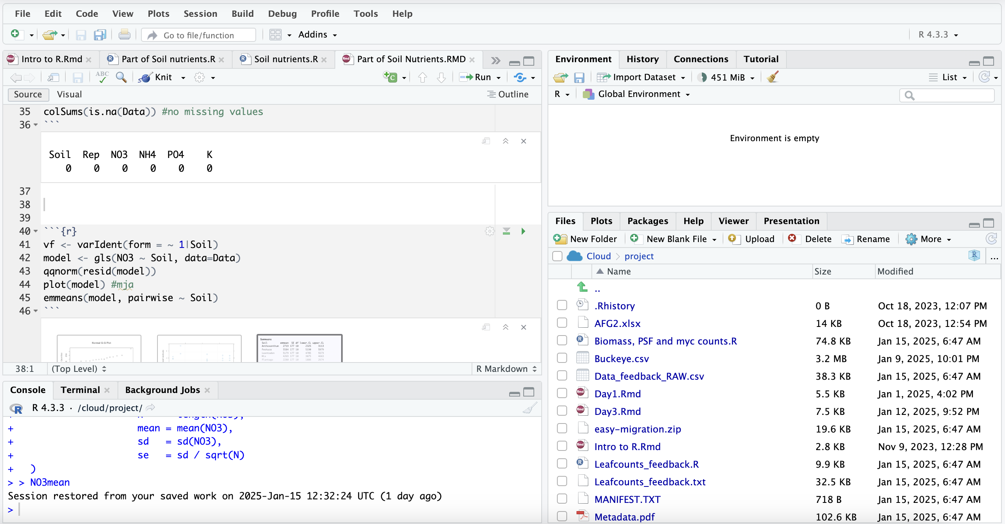

Slide 5
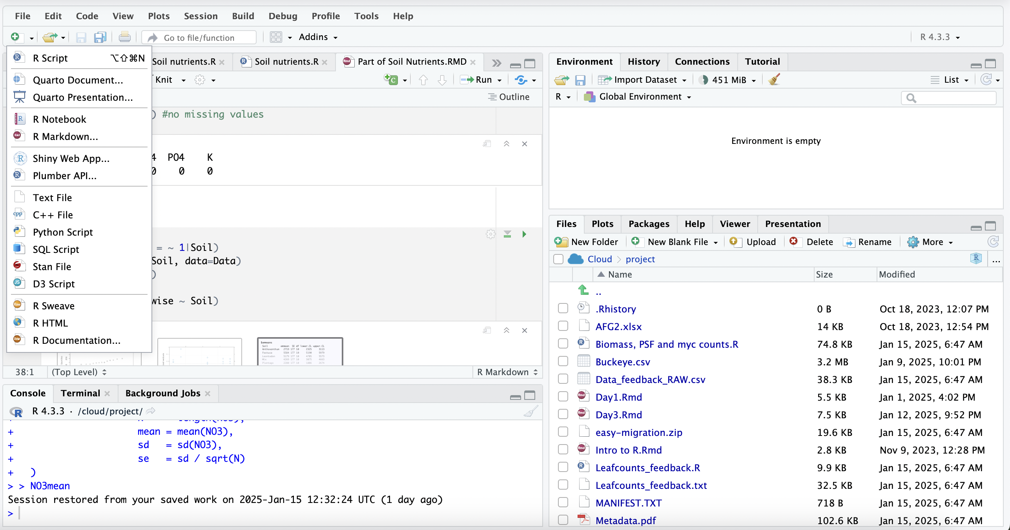

Slide 6
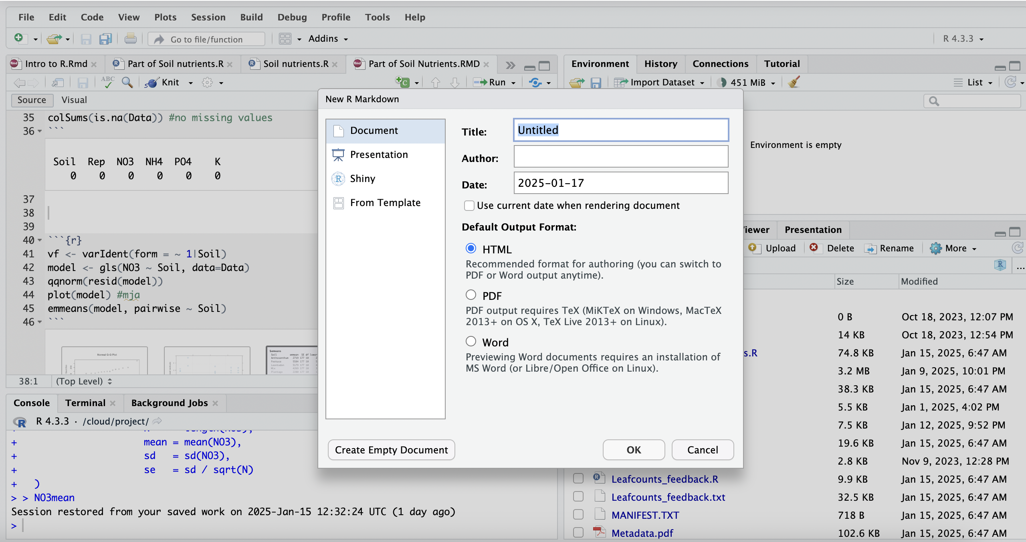

Slide 7
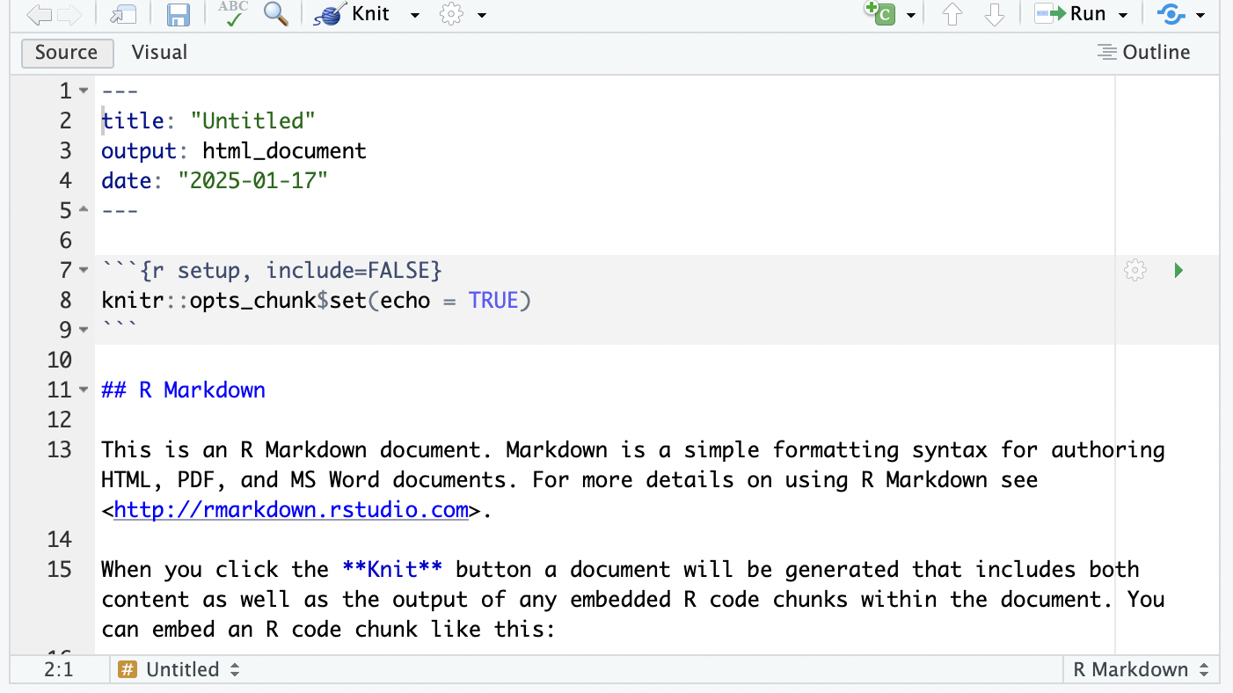

Slide 8
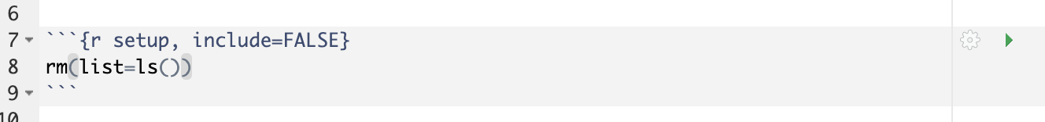
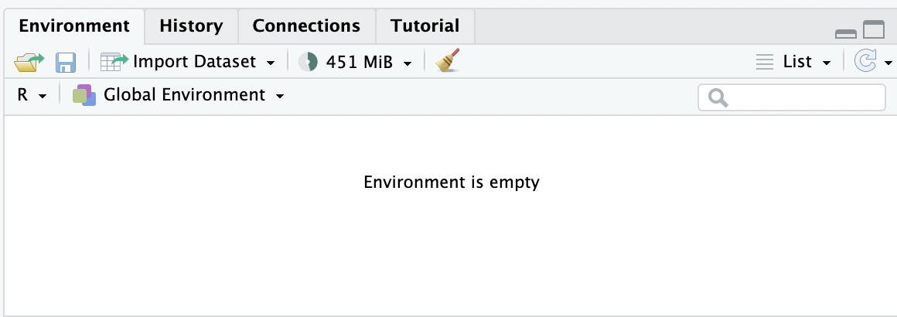
Or

Slide 9
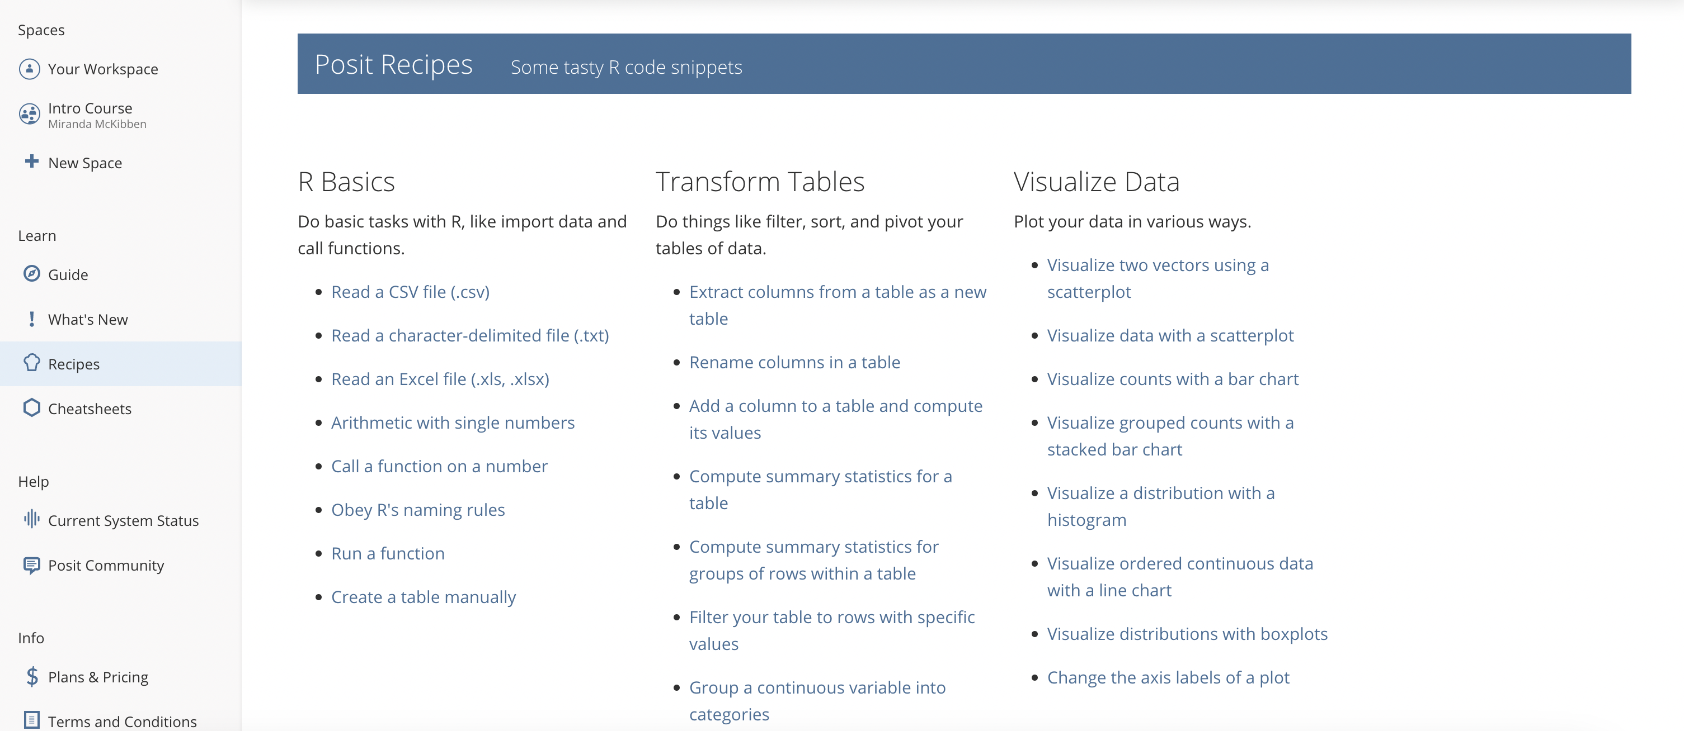

Slide 10
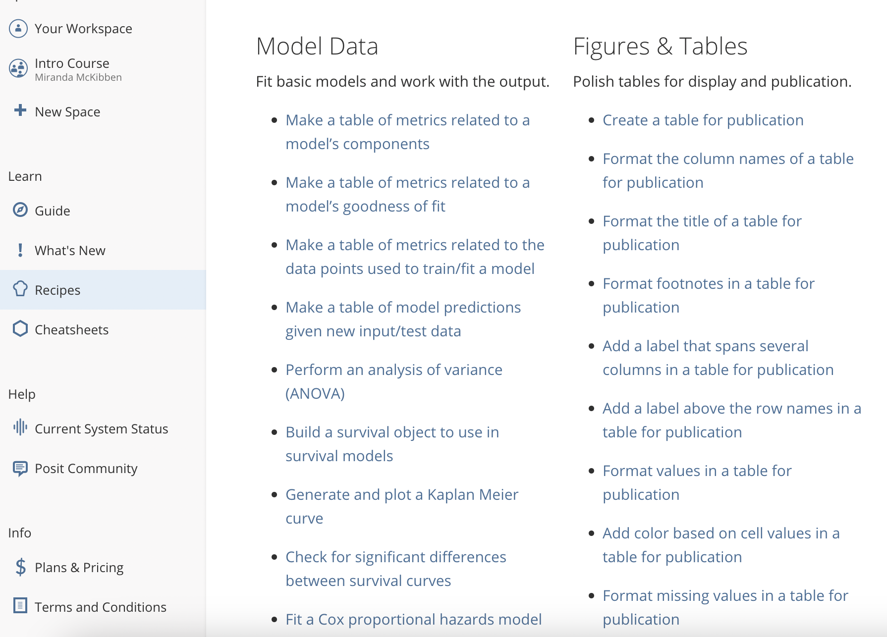

Slide 11
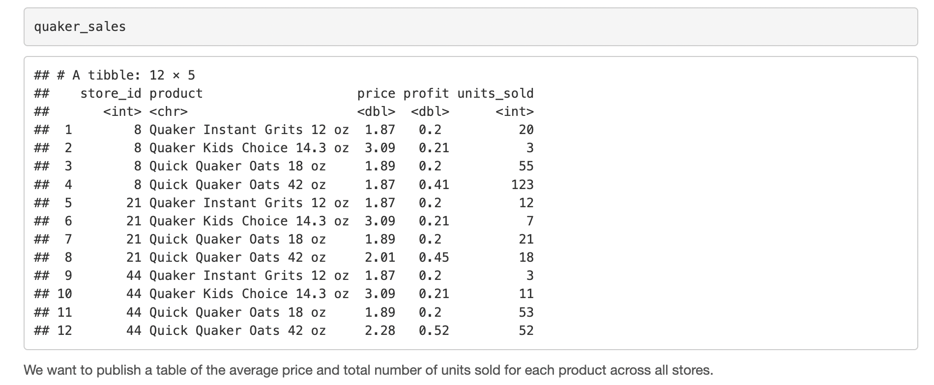
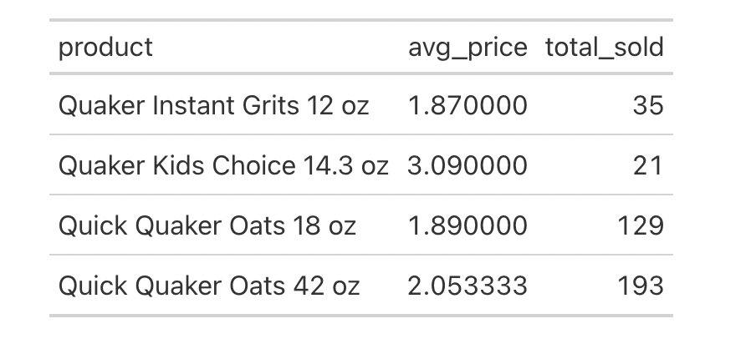
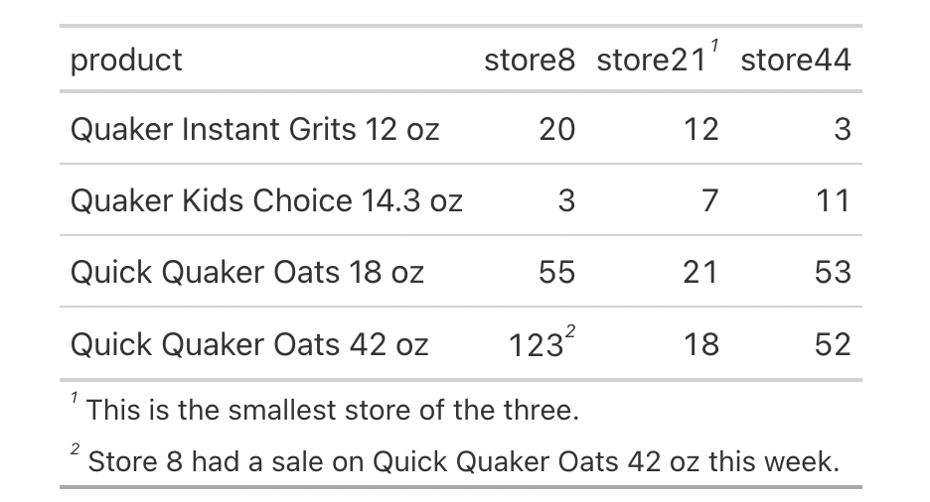

Slide 12
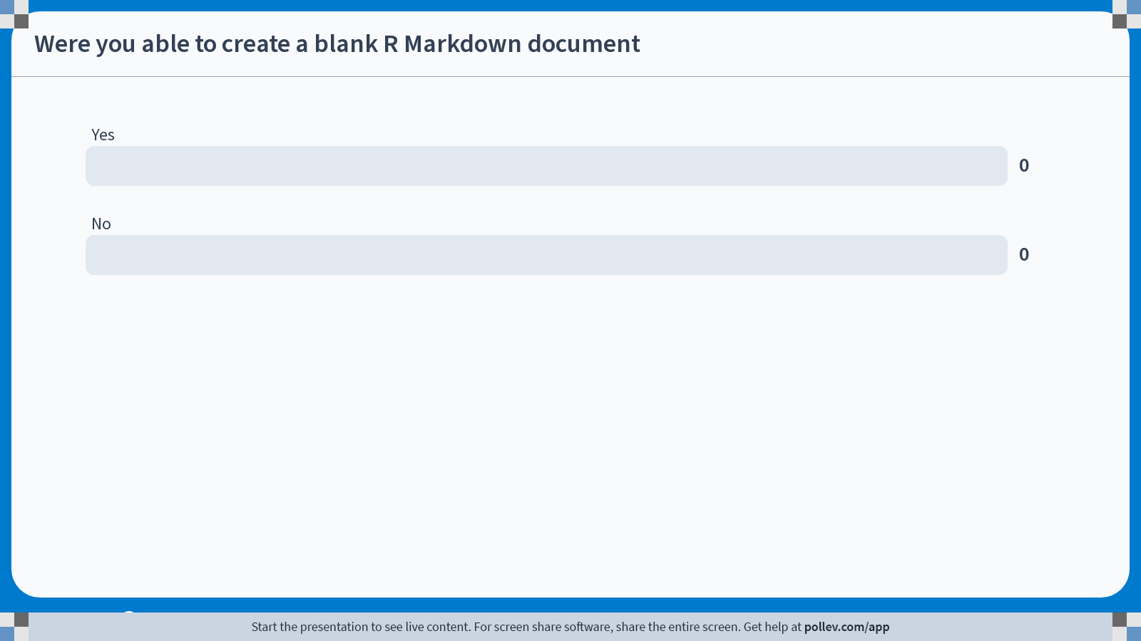
Notes:
Do not modify the notes in this section to avoid tampering with the Poll Everywhere activity. More info at polleverywhere.com/support Were you able to create a blank R Markdown document
https://www.polleverywhere.com/multiple_choice_polls/BMmEEP3wzl4XjUEg4ugVf?state=opened&flow=Default&onscreen=persist

Slide 13
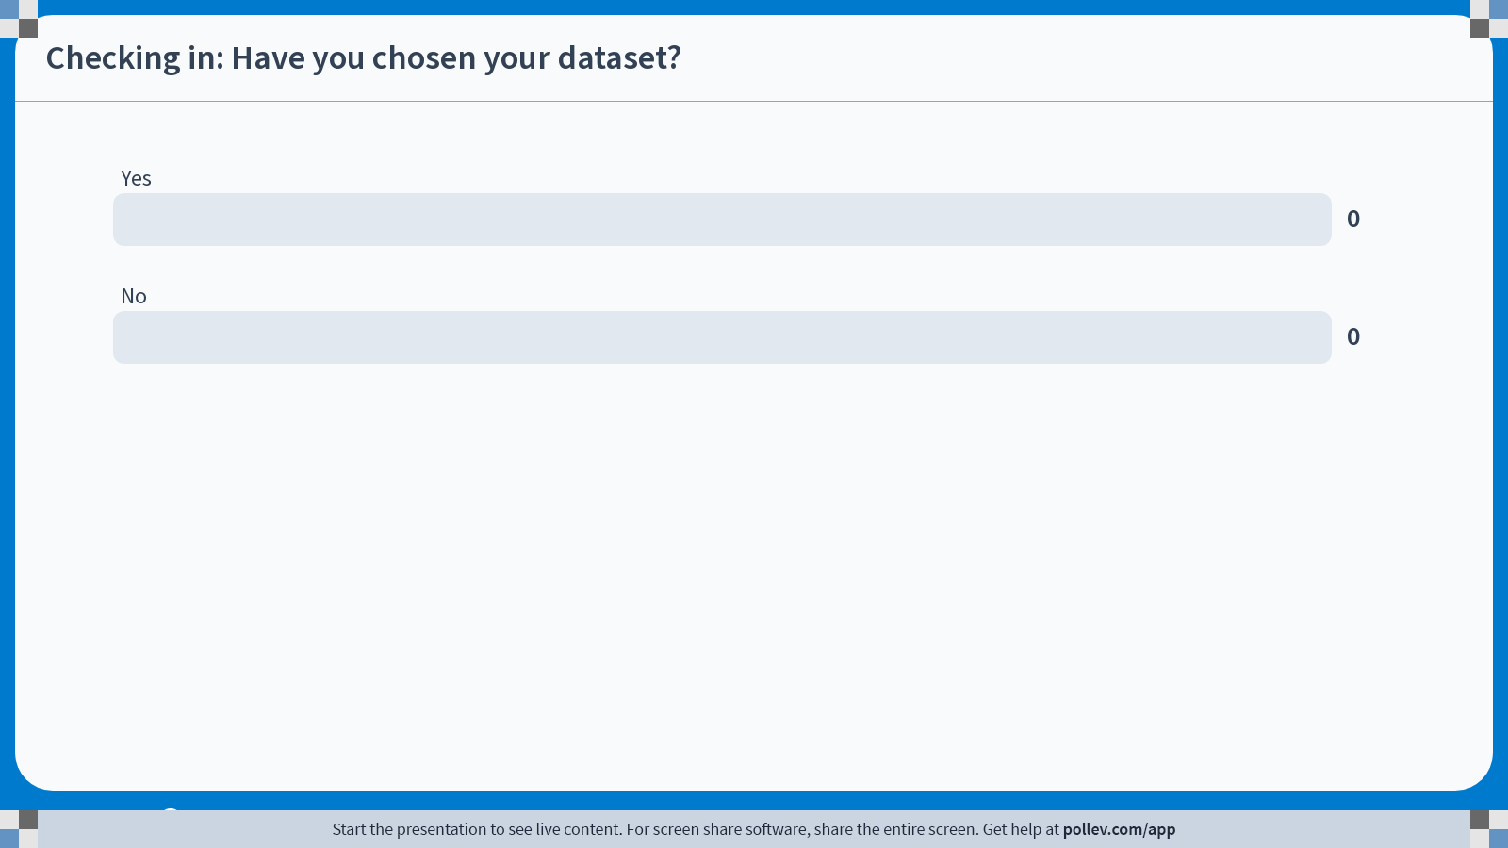
Notes:
Do not modify the notes in this section to avoid tampering with the Poll Everywhere activity. More info at polleverywhere.com/support Checking in: Have you chosen your dataset?
https://www.polleverywhere.com/multiple_choice_polls/kHcdB2uFl73OGHiyToMSc?state=opened&flow=Default&onscreen=persist

Slide 14
Reminder: Before you begin your analysis you should have two hypotheses:
Null hypothesis: There is not a significant relationship between the things you are comparing.
Alternative hypothesis: There is a significant relationship between the things you are comparing.

Slide 15
A hypothesis should be specific and testable.
Begin writing your hypotheses. If finished in class today, exchange your hypotheses with a partner to get feedback.

Slide 16
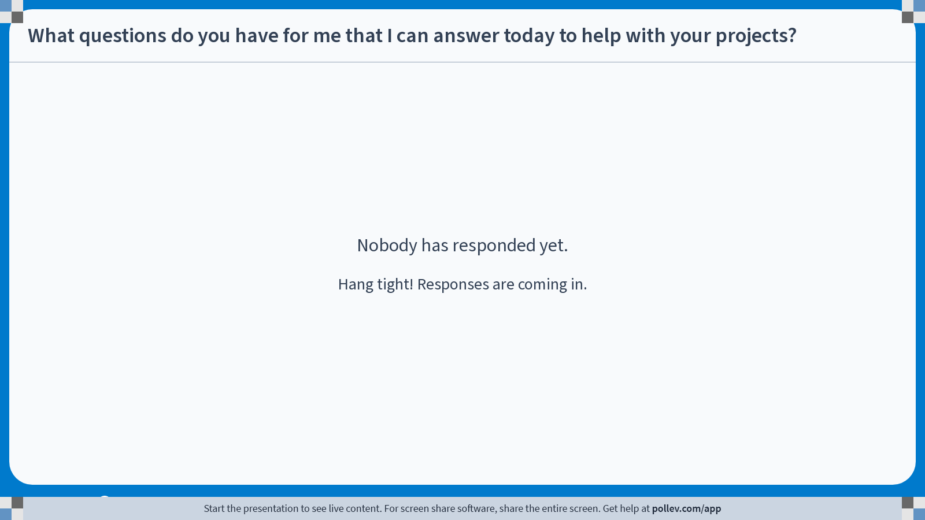
Notes:
Do not modify the notes in this section to avoid tampering with the Poll Everywhere activity. More info at polleverywhere.com/support What questions do you have for me that I can answer today to help with your projects?
https://www.polleverywhere.com/discourses/D1Uk2maeT30QWuS8fv2qD

Slide 17
Bar graph
Advantages
Disadvantages
Easy to understand
Summarizes large datasets
Quickly compares categories
May hide the distribution of the data points
Requires discrete data

Slide 18
Box and whisper plot
Advantages
Disadvantages
Shows distribution of data points
Great for large datasets
Not good for small datasets
Displays outliers

Slide 19
Scatterplot
Advantages
Disadvantages
Shows the relationship between continuous variables
Can be useful for visualizing groups/clusters
Difficult to isolate individual data points
Difficult to interpret with large datasets

Slide 20
Line graph
Advantages
Disadvantages
Shows direct relationship between variables as they change over time
Great for comparing the amount of change between each x-axis unit (comparing slopes)
X-axis should be text, y-axis numerical
Can be difficult to plot if you have fractions or decimals

Slide 21
Histogram
Advantages
Disadvantages
Good for visualizing large datasets, continuous data
Good for quick comparisons between groups
Does not show exact data points
Interpretation can vary based on bin size

Slide 22
Distribution map
Advantages
Disadvantages
Can show geographical trends
Requires latitude and longitude data

